Slide 1
Good Practices/Models in Youth Enterprise Development
Cassim Parak
The Coir Institute
Tuesday, 10th May 2011
Notes:
1

Slide 2
“Education is the most powerful weapon, which you can use to change the world.”
Nelson Mandela

Slide 3
Youth Enterprise Development South African Regulatory Landscape
An Act of Parliament - The Bill established
National Youth Development Agency (NYDA) as a structure and launched on 16 June 2009
The merger of Umsobomvu Youth Fund (UYF) and the National Youth Commission (NYC)
Representation of the broad spectrum of people of South Africa
Special attention - issues such as race, gender, disability and geographical spread
Funding – National Budget, Disbursements from Lotteries & Gambling Remittances, Demutualisation of Insurance Companies, Private Sector Programs

Slide 4
NYDA – Aims & Objectives
Advance youth development through guidance and support to initiatives across sectors of society and spheres of government.
Initiatives to advance the economic development of young people.
Contribute to vibrant, equitable and sustainable rural communities with food security for all
Develop and implement an Integrated Youth Development Plan and Strategy for the country.
Enhance the participation of young people in the economy through targeted and integrated programmes
Support businesses and social enterprises that promote job placement, self-employment and income-generating activities for youth

Slide 5
NYDA – Key Performance Areas
The KPAs serve as a guideline as the NYDA tackles young people’s challenges, particularly those based in the rural areas and those with disabilities.
Achieved through supporting self-employment initiatives, linking young people to job opportunities, providing information about opportunities and referring them to the relevant organisations and offering free career guidance at its youth centres.
Economic Participation
Education and Skills Development
Effective and Efficient Management of Resources
Information Services and Communications
National Youth Service
Policy, Lobby and Advocacy
Research, Monitoring and Evaluation
Social Cohesion

Slide 6
NYDA – Financing Youth Entrepreneurs
Enterprise Finance aims to promote entrepreneurship among young people, providing funding to youth aged 18-35 years old to help them start a new business or grow an existing one
SME Funding
Youth (aged 35 and younger) must hold greater than 26% of the shares in the company and be operationally involved in the business
Must be a previously disadvantaged South African youth
Must demonstrate commitment to the venture
The venture must be economically viable
Micro-finance
To promote entrepreneurship among young people - loans ranging from R1000 to R100 000 to youth aged 18-35 years old
The loan is divided into 8 different products where finance is structured according to the amount requested, affordability indicators and the type of finance required
The terms are tailored around the individual’s requirements
To apply for a micro loan, the entrepreneur must be a South African aged 18 to 35, who is or plans to be very involved in the business
Submit a business plan, and be able to show that the new or existing business will be able to repay the loan.

Slide 7
NYDA Overall Successes
Numerous young people have been assisted since the NYDA’s establishment including:
Disbursing loans to microfinance enterprises
Disbursing Small and Medium Enterprise loans
Disbursing Business Consultancy Services Vouchers
Engaging youth under the National Youth Service Programme
Entrepreneurship development training

Slide 8
NYDA programme addresses Artisan skills shortage
NYDA Accelerated Artisans and Skills Training Programme
Designed for historically disadvantaged unemployed young people between 16 and 35 who do not have skills to access economic opportunities, includes life skills and job preparedness training
Electrical, Plumbing, Boiler making, Welding, Bricklaying, Carpentry, Forklift, Computer numerical control programming or Air conditioning and Refrigeration training
NYDA financial and non-financial business support programmes and services
The Business Consultancy Services Voucher Programme
The Volunteer Mentorship Programme
The Business Opportunities Support Services

Slide 9
NYDA Program - Young Women
Advocates women development and rights, encourages young women to support each other and to share their experiences and challenges, particularly those based in rural areas.
Recognition that young women are assets and active agents for change who can contribute their energy and insights to the country and their communities’ growth and progress
Pathway to job creation and decent work for young women in entrepreneurship and supporting a substantial number of women through access to economic opportunities such as salons, fruit and vegetable stalls, food caravans and fashion design businesses
Focus on ensuring that they get the basics right
Business Consultancy Services Voucher Programme - Business registration, website development, bookkeeping and marketing support services
Business Loan Finance - R1, 000 to R5-million
Linkages between up-and-coming and established women entrepreneurs.

Slide 10
NYDA Program – Other Successes
Free Training for Film Makers in conjunction with Industry Stalwart (DSTV)
Proud to Serve campaign - young people recruited to volunteer their services to disseminate information on TB, Malaria, HIV/Aids, environmental degradation, drug abuse awareness, cleaning up of schools hospitals and clinics as well as social cohesion and nation building in their communities through the promotion of national symbols, national anthem and flag
‘Start Here’ campaign was established through the Youth Advisory Centre to deal with the increased amount of young people that are in need of Career Guidance having successfully or unsuccessfully matriculated but not knowing which steps to take afterwards. They are assisted with opportunities and referrals related to education and training, job preparedness and starting a business

Slide 11
“Our goal is clear. We want to have a country where millions more South Africans have decent employment opportunities, which has a modern infrastructure and a vibrant economy and where the quality of life is high. We all have a responsibility to work hard to make this a reality. Everyone must think of how they can contribute to the jobs campaign through creating opportunities for themselves and others.”
South Africa: State of the Nation Address by President Jacob Zuma
10/2/2011

Slide 12
Social Enterprise
Social enterprise is about applying typical business models:
Delivering sustainable & meaningful change within society and the environment.
It is about making the world a better place.
Emerging field, evolving definitions & practices.
Measured by the success of social & environmental impact
Profitability/Sustainability is a necessity in achieving the mission.

Slide 13
Relevance of the Social Enterprise in Youth Entrepreneurship
Focus is on making positive change when we need it most.
Much more responsive mechanism with little to no dependence on political regimes and foundations.
Scalable and very versatile in meeting the needs of the communities and environments in which they serve, with little to no dependence on state welfare and charities.
Active and engaged stakeholders, employees, owners, suppliers and customers.

Slide 14
ECO-NO-MONEY 1.0
Mainstream Failures
Discouraged Traditional Activities
Food Inflation & Poverty
Failure in managing Earth’s Natural Resources
Un-Education
Capitalism as a negative employment driver
Business Monopolies are Government’s best friends
Mergers & Acquisitions killing Youth entrepreneurship
Rules that promote economic meltdowns
Technology & Outsourcing inhibiting large scale employment
The Brand Bite – Market Dominance & Not Share

Slide 15
ECO-MONEY 2.0 – The Future of our Youth
Mainstream Functions – Best Practices
Encourage Traditional Activities Among Youth as a PROCESS
Education-Employment-Empowerment-Entrepreneurship
Managing Earth’s Natural Resources
Food Poverty Alleviation – Self Help Mechanisms
Youth Entrepreneurship & Employment
Education Focus
Natural, Renewable, Sustainable Resources - Mainstreaming
Social Capitalism as a Positive Trend
Motivate Youth Entrepreneurship through Participation Programs
Remuneration - Progress & Promotion Alignment
Wealth Share
Elders to Youth Medley Teams
Mentorship basis of Skills Transfer, Methodology
Monitoring & Evaluation
Skills Shadow & Internships

Slide 16
Background
Established as a green-field operation in 2007
Capitalised by other business interests
e.com institute – eBusiness Solutions & Consulting Firm
Operational (self sustaining) in 2010
Headquartered in South Africa
Sourcing base – Kerala MSMEs
Customers – primary base is SA
Medium & Large Corporations
MSMEs & speciality users
International Trading Capability
enables business activities at a global level
eCommerce basis of trade
Natural
Renewable
Bio-degradable
Community-centric
Environmentally Friendly

Slide 17
Toward Sustainability
Building & Construction
Road Construction
Landscape Shaping
Furniture & Décor
Horticulture, Agriculture & Floriculture
Soil Conservation & Erosion Control
Food & Beverage
Hospitality & Tourism
Research & Develop new Products for new Targets
Social Youth Enterprises play a pivotal role in Nature Conservation and Climate Change Matters

Slide 18
The Model
Managed as a Business
Finance & SCM, Marketing & Sales, Training, etc.
Measured by Growth:
Employee Competence
Unskilled/Uneducated Youth Employees
Adoption of Products by Medium & Large Corporations
Success of Impact on Environment
Sourcing from MSMEs
Involvement of MSMEs
Communities Sustaining Earth using Natural, Renewable, Bio-degradable Resources

Slide 19
Coconuts – Abundant Sustainability
Coconuts are harvested every 45 days throughout the year

Slide 20
COIR – A NATURAL COCONUT FIBRE
Natural & Renewable
Eco-Friendly
Bio Degradable
Cost-Effective
Maintenance Free
High Specific Strength & Stiffness
Water, Chemical and Atmospheric Corrosion Resistance
Termite & Insect Resistance
Long Life and Durability

Slide 21
Target Sectors
Roads & Railways
Marine, Rivers & Dams
Environment & Bio Diversity
Mining & Industrials
Sports & Recreation
Horticulture, Floriculture
Agriculture
Civil Engineering & Construction
Landscaping & Nurseries
Automotives
Mattress Manufacturers
Industrial & Consumer Matting
The Coir Institute distributes a wide range of natural, renewable and bio-degradable products manufactured from Coconut fibre, with applications across a diverse spectrum of environmental mediums.

Slide 22
The Products
Coir Geo textile - Slope Stabilisation & Erosion Control, Mine Dump Rehabilitation, Filtration
Coir Logs - Protection of dams, rivers, streams, etc.
Coir Peat & Coir Chips – Soil-Less Growing Medium
Coir Gardening Articles – Pots, Baskets, Liners, Discs, etc.
Coir Fibre – horticulture applications
Coir Ply & Composites - Furniture, Flooring, Blinds, etc.
Coir Mats & Matting - decorative floor mats
Natural
Renewable
Bio-degradable
Community-centric
Environmentally Friendly

Slide 23
Barbeton Mines South Africa
Toxic mine dump rehabilitation process. Involves the laying of Coir Stitched Erosion Control Blankets and hydro-seeding to propagate vegetative growth.

Slide 24
Protection of Stream
Densely-packed coir logs placed on a stream.

Slide 25
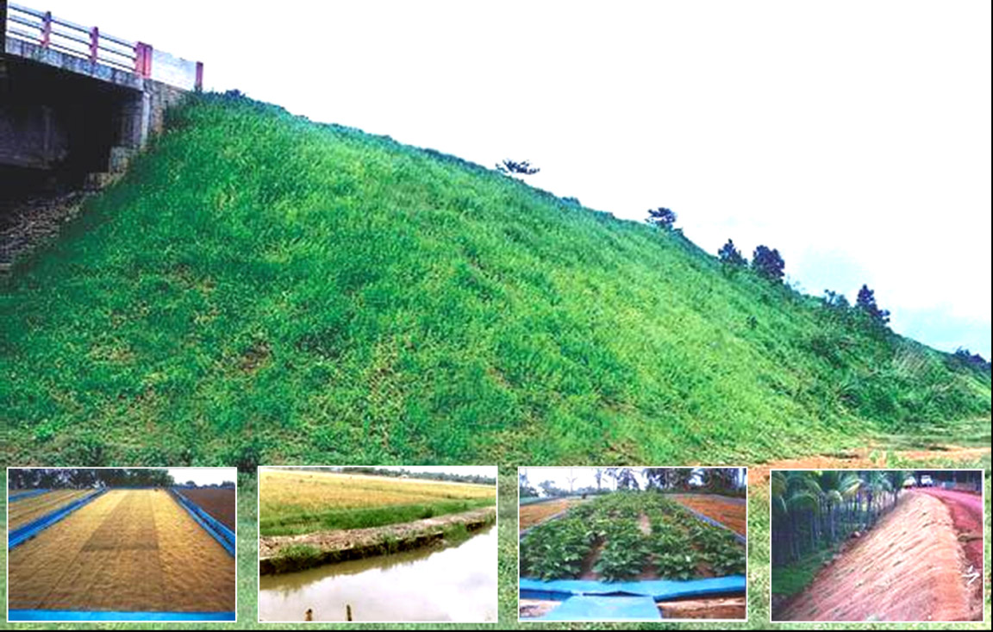
Coir Geo Textile Applications
Applications
Roads & Bridges – Slope Stabilisation
Roads - Separator
Canal Embankment Protection
Protection of soil sliding in Railway cutting
Soil mulching, consolidation, rehabilitation
Agricultural land protection
Erosion Control
Drainage/Filtration
Weed control
Golf Courses & Recreational Areas
Bio diversity management
Mine Tailings

Slide 26
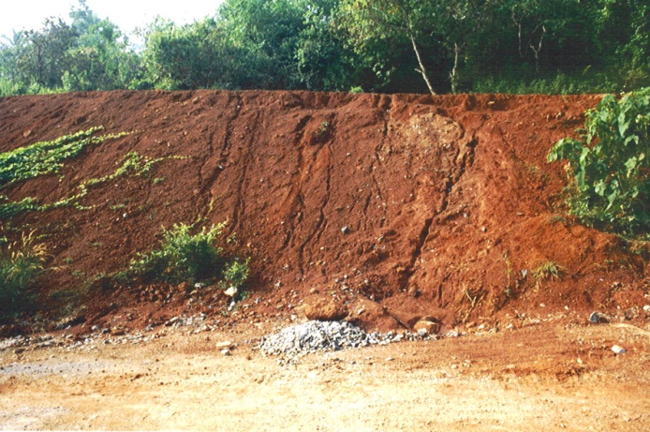
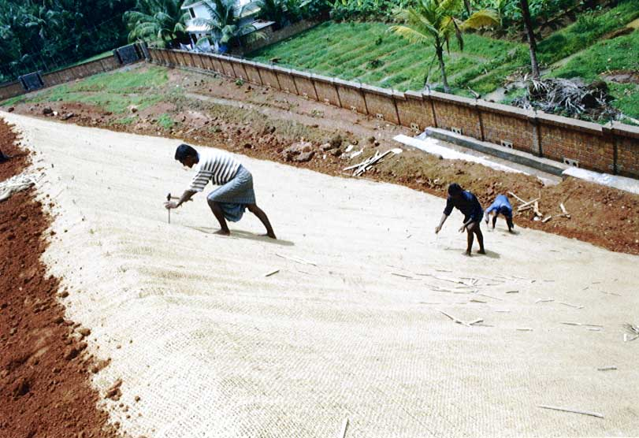
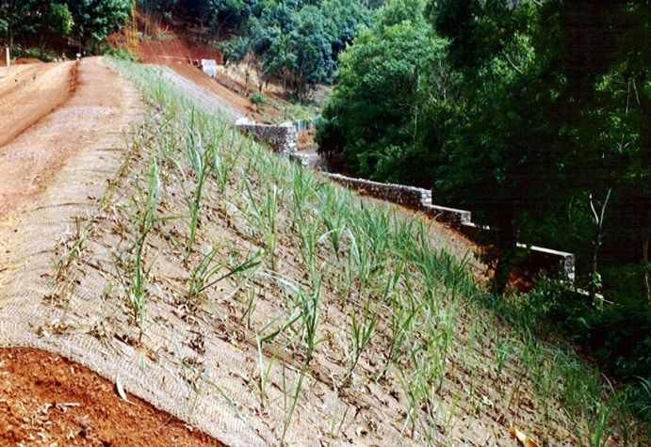
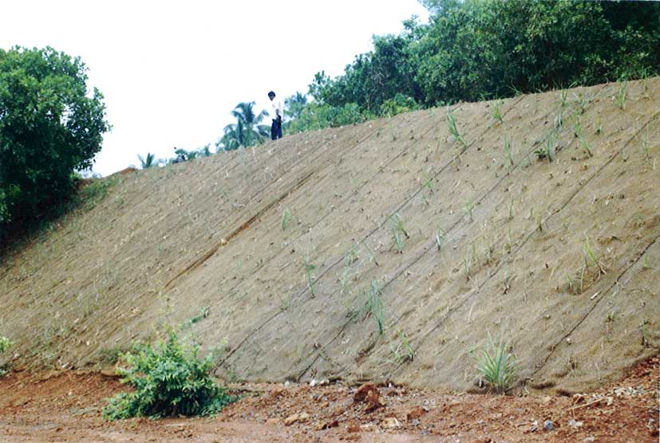
Erosion Control with Coir Geotextiles
Eroded Slope Stabilisation

Slide 27
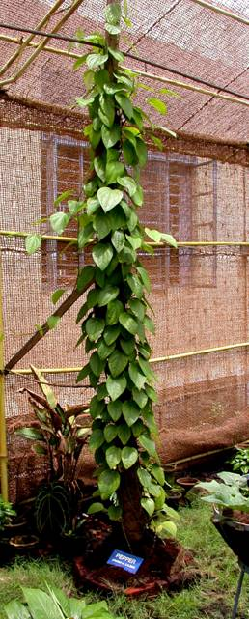
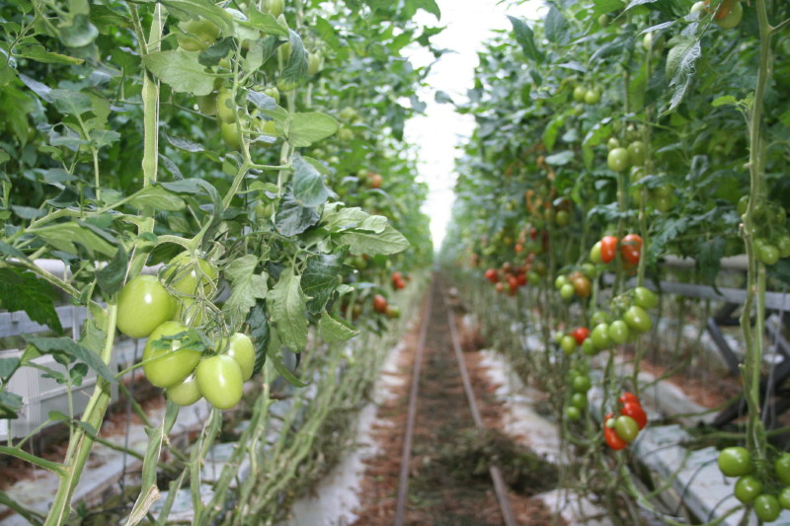
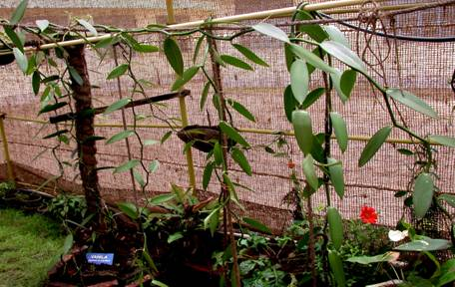
Coir Peat & Chips in Agri-Horti Culture
Anthirium
Tomatoes
.
Pepper
Vanilla

Slide 28
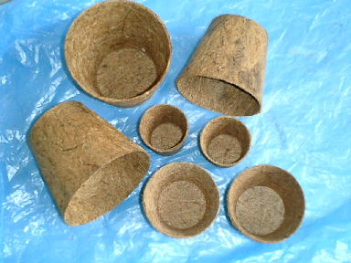
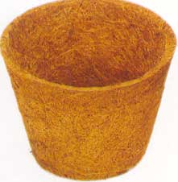
Coir Garden Articles
Chemical Properties
Physical Properties
Ultimate length |  | 0.6 mm
Diameter/width |  | 16 micron
Single fibre | Length | 6 to 8 inches
 | Density | 1.4 g/cc
 | Tenacity | 10 g/ tex
Breaking Elongation |  | 30%
Moisture regain at 65% RH |  | 10.5%
Swelling in water |  | 5% in diameter
Water solubles | 5.25%
Pectin & related compounds | 3.30%
Hemi-Cellulose | 0.25%
Cellulose | 43.44%
Lignin | 45.84%
Ash | 2.22%

Slide 29
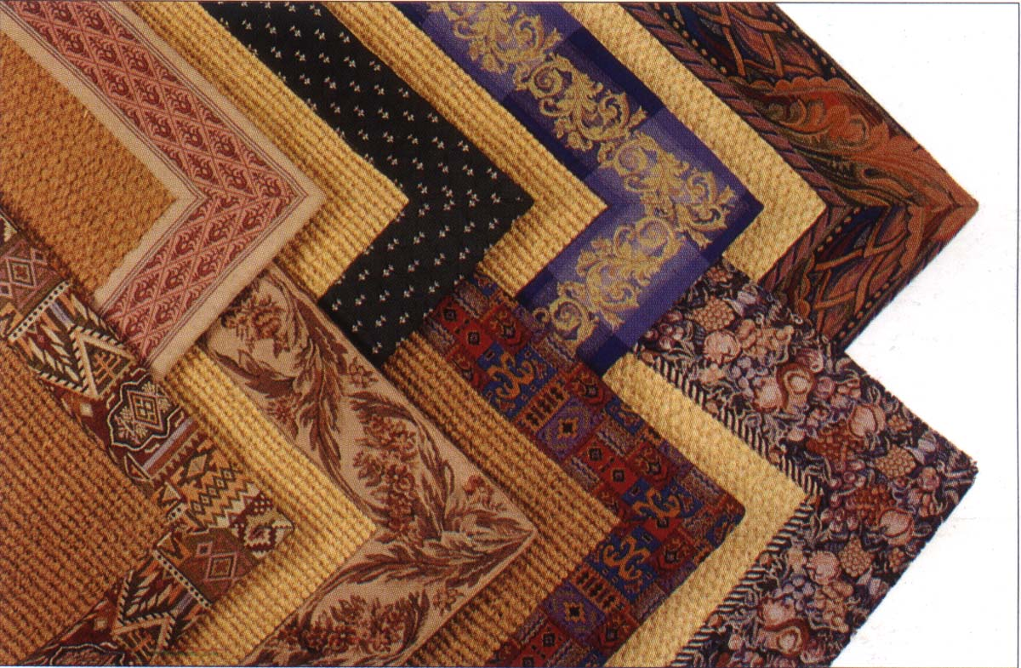
A Wide Range of Natural Products

Slide 30
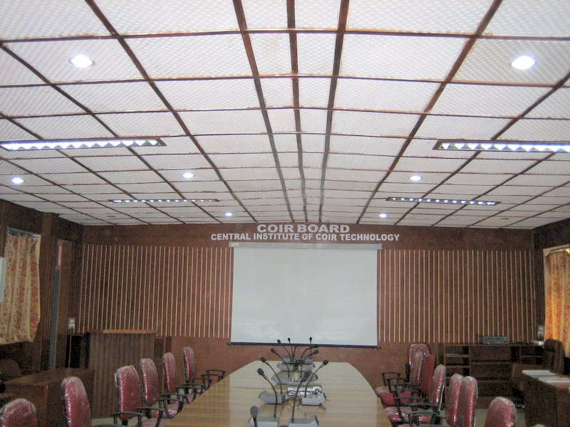
Coir Ply as a substitute for Wood

Slide 31
“…Let there be work, bread, water and salt for all…”
Nelson Mandela

