Slide 1
Elephant Dung Paper
An Ethical Product from Sri Lanka

Slide 2
Conceiving Pains…
In 1997 we conceptualized a new, socio – economic – ecological
program based on sustainability, at a time when “global warming” was
not a hot topic !
Achieved with the predominant help of our rural youth.
Face many obstacles to youth empowerment within our organization.
Overcome these obstacles through heavy investments in our own in – house
training programs.
“Conservation through Innovation”

Slide 3
Growing Pains….!
Started manufacturing paper from the paper waste of our family
printing press.
Money – From savings
First machine – Hollander beater to pulp cellulose fiber
( Larger version of Kitchen blender)
First employees – Seven including me
Location – Abandoned brick making plant in kegalle
Then we started pulping different natural fibers like banana bark,
sugar cane baggash, ladies fingers bark.
“Conservation through Innovation”

Slide 4
Helping Ourselves…
Prepared ourselves in detail when making representations to institutions.
Took the professional step to brand / patent.
Hired expert consultants.
Keeping feet on ground.
Communication……its all about English!
“Conservation through Innovation”

Slide 5
Help from outside…
Public Sector
IDB where we first went and received advise from consultants on machinery fabrication.
IRDP Loan at a concessionary rate with minimum / flexible security.
EDB organized market orientation program to Europe where we got our first European buyer.
“Conservation through Innovation”

Slide 6
Pitfalls
Rising costs
Recession
Labour intensive
Limited demand
Changing trends / styles
“Conservation through Innovation”

Slide 7
Process – Dung to Dollars !
Eat
Dung
Boil
Pulp
Papers & Products
“Conservation through Innovation”

Slide 8
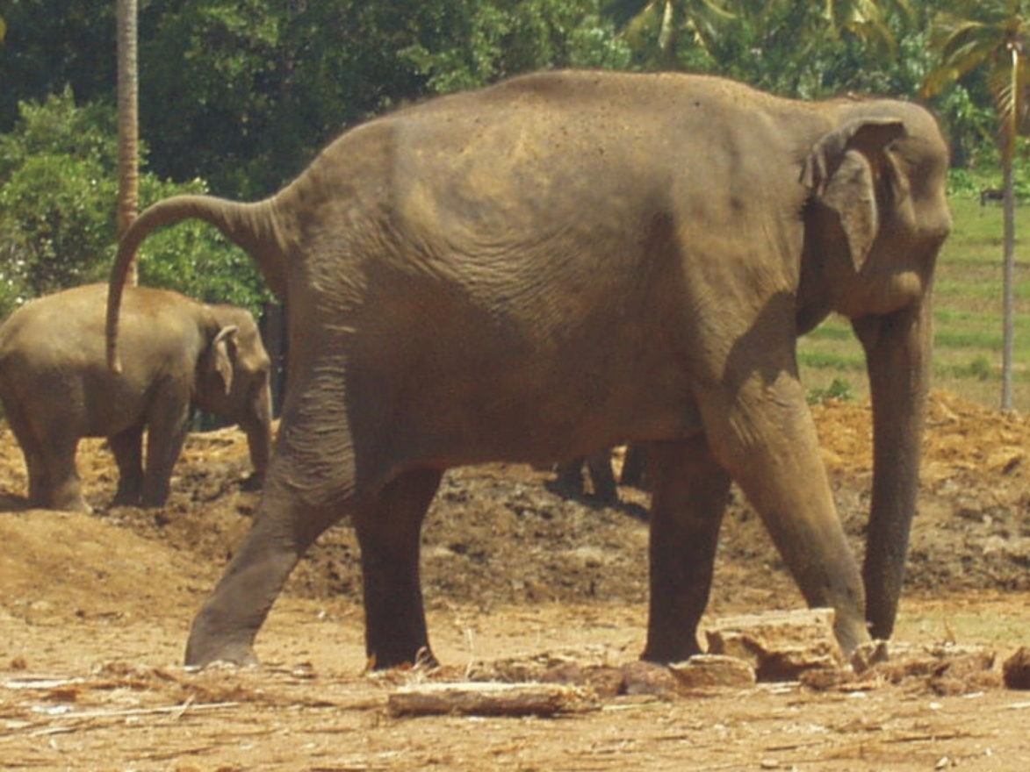
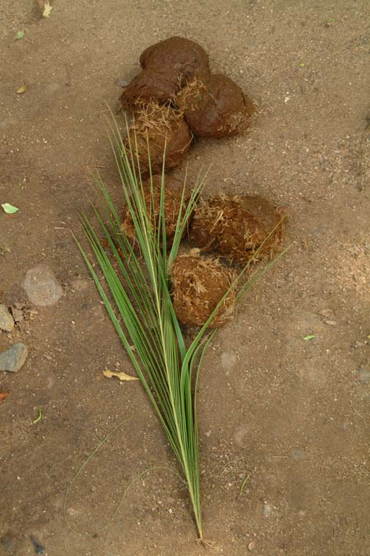
Weighs 3500 - 4000 kg , Needs to consume 4-6% of its body weight or 150 kg as food everyday.
“Conservation through Innovation”

Slide 9
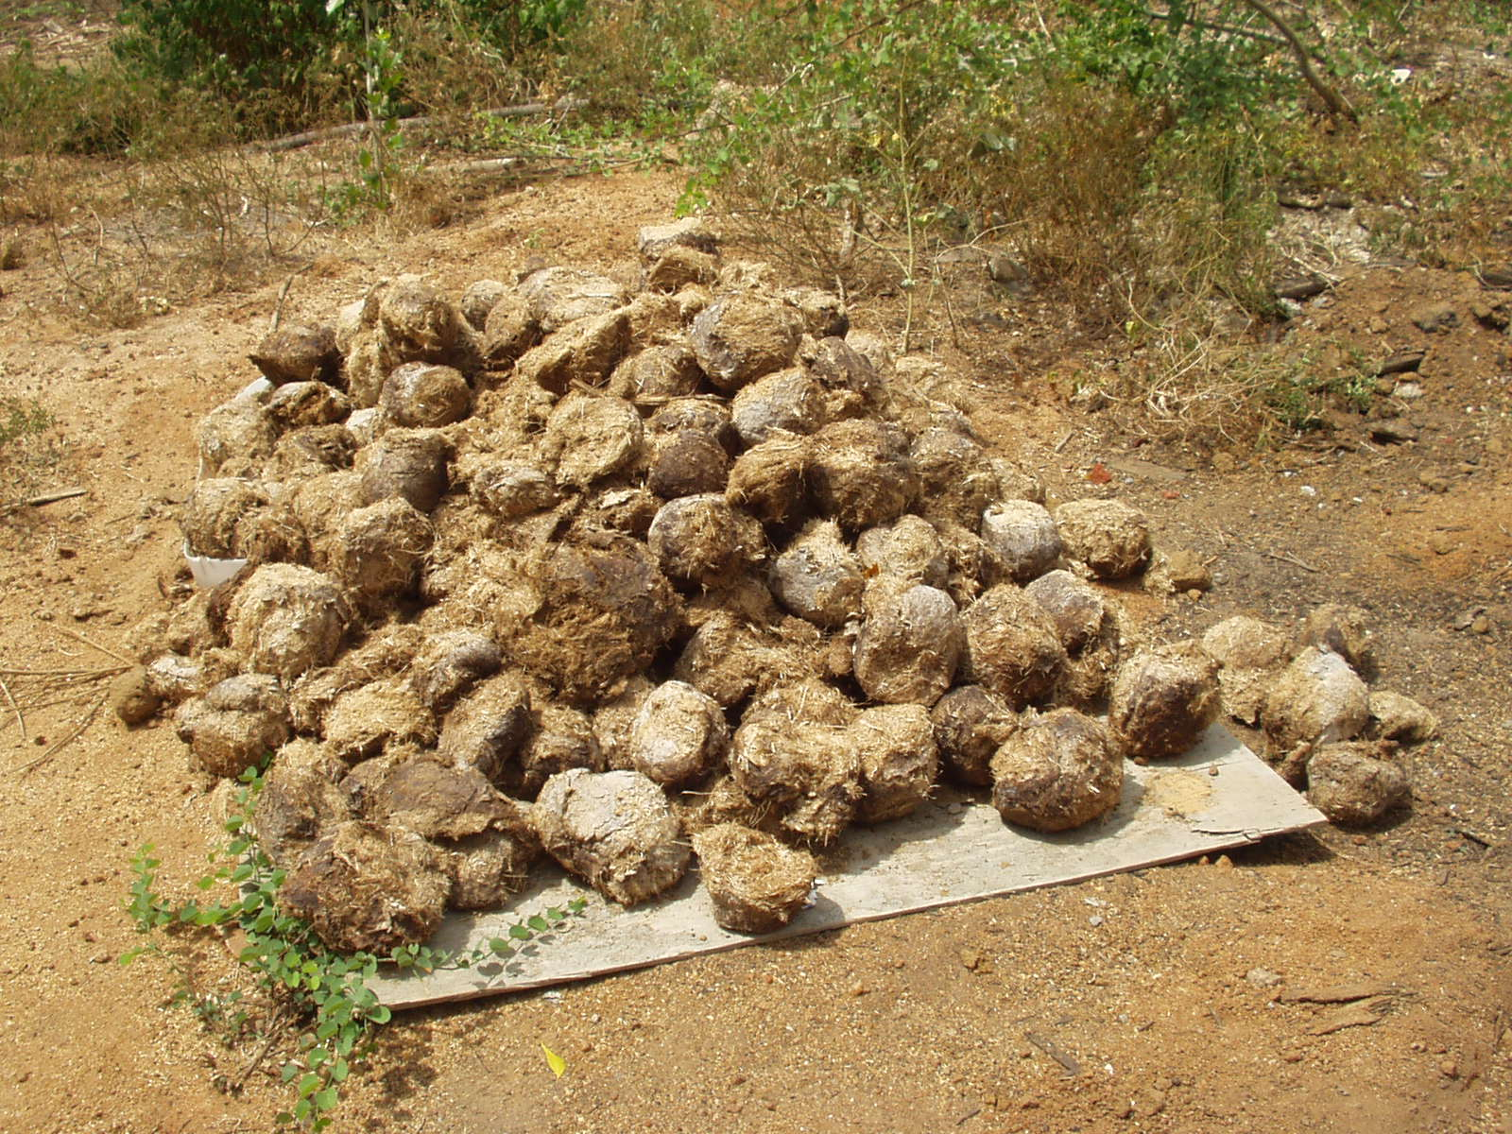
Defecates 16 times or 180 kg on average of which 30 - 40% is water. 10 to 12 elephants produce a ton of dung everyday.
.
“Conservation through Innovation”

Slide 10
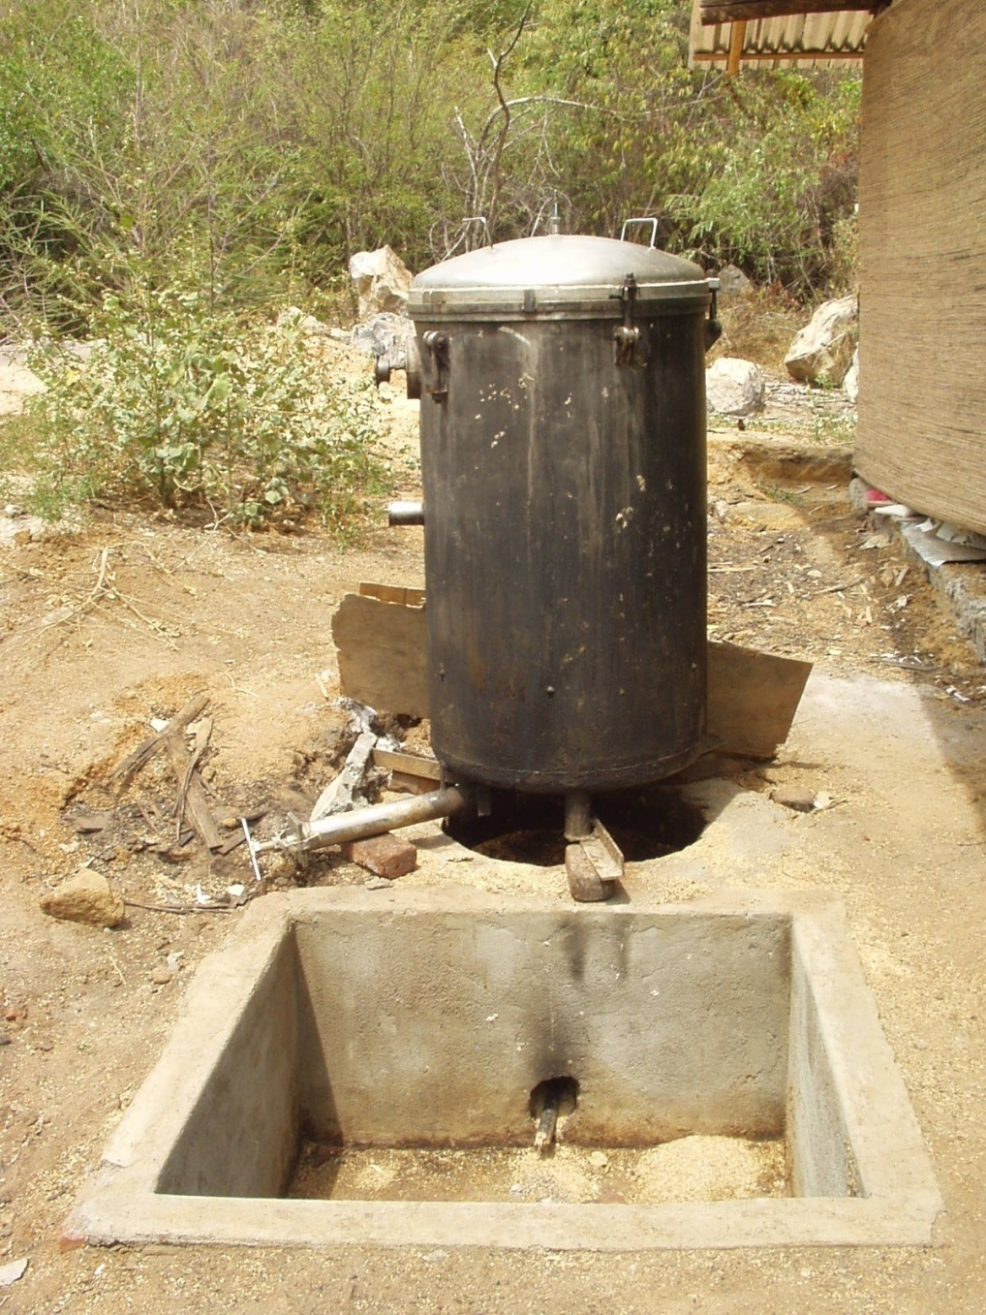
“Conservation through Innovation”

Slide 11
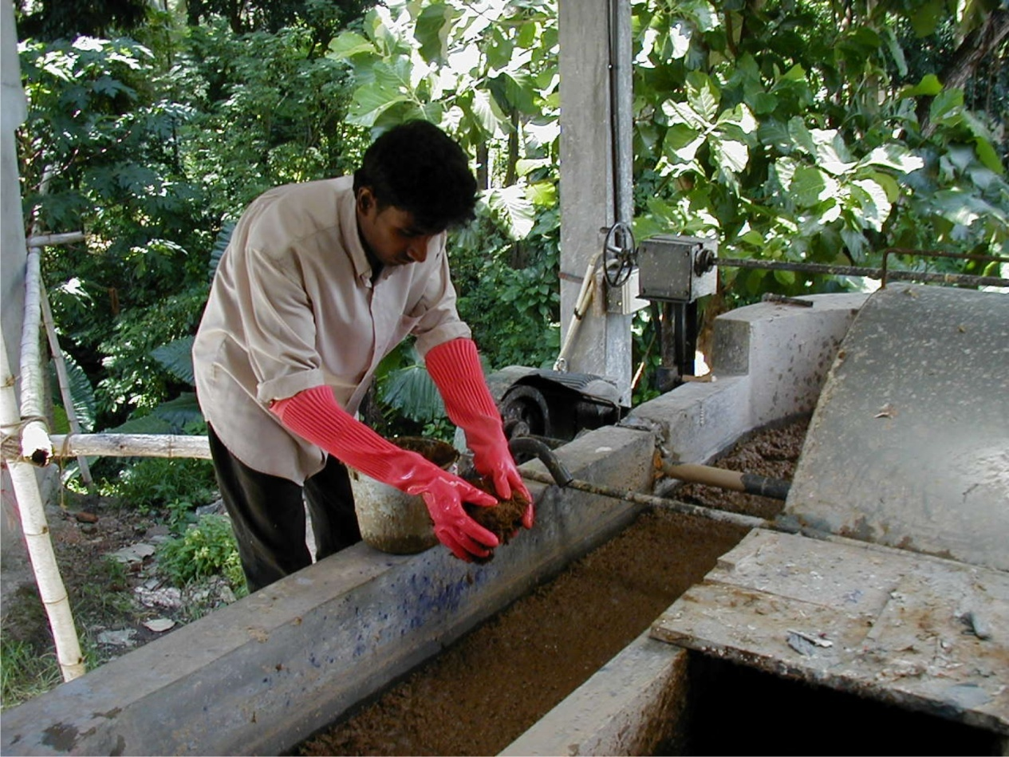
10 kg of dung makes 120 sheets (720 A4 sheets) of handmade paper One ton of dung or ten elephants make 72,000 A4 sheets of paper everyday
“Conservation through Innovation”

Slide 12
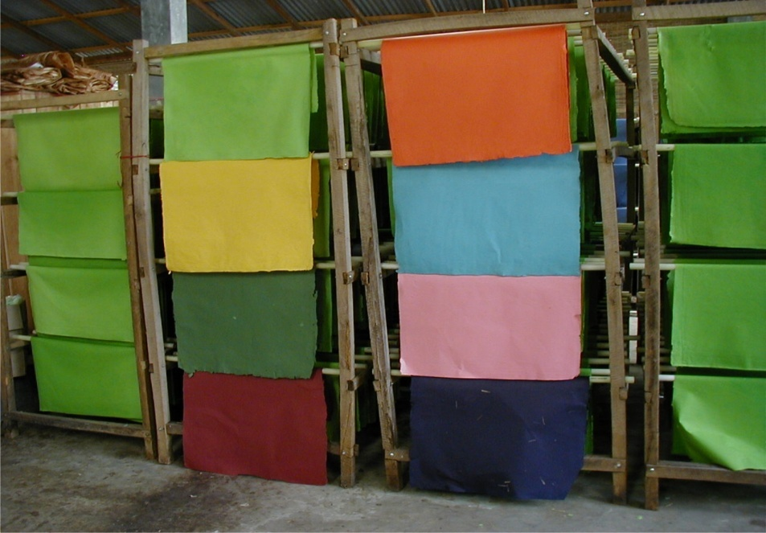
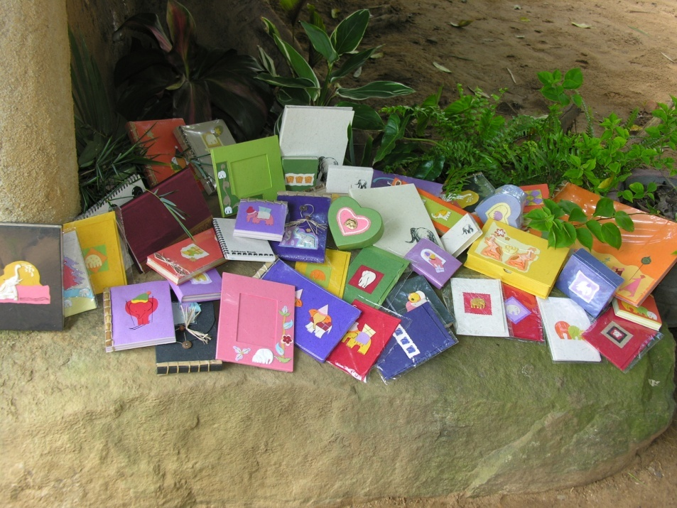
It is proved that the elephant dung is perfect for paper making.
In fact it is not wrong to say that the elephant is the worlds only
100% Eco Friendly living paper mill! It pulps fibrous bark and
leaves in its stomach naturally as against paper mills that uses virgin fiber,
chemicals, uses a lot of energy and are known to be amongst the world’s top
polluters of the environment.
“Conservation through Innovation”

Slide 14
Canada
United Kingdom
U.S.A
Netherlands
Germany
Belgium
Italy
Austria
France
Japan
Hong Kong
Thailand
Sri Lanka
Singapore
Maldives
Australia
“Conservation through Innovation”

Slide 15
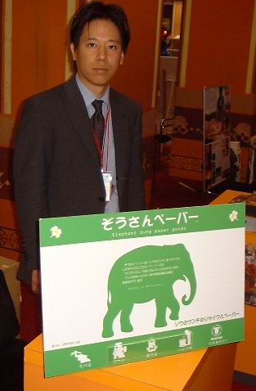
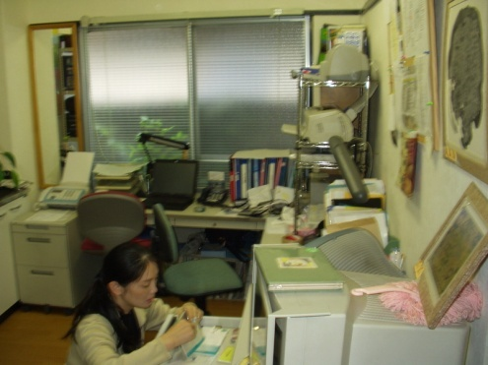
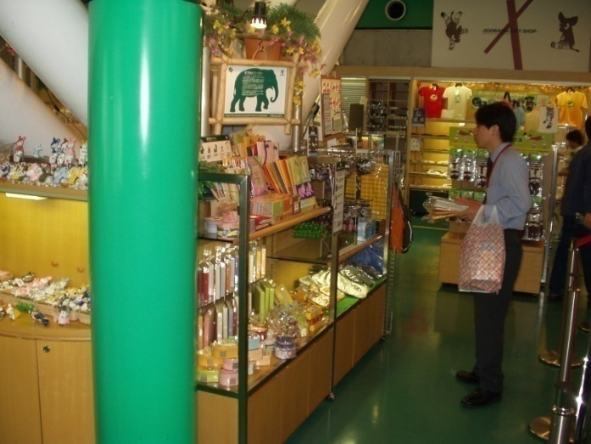
Japan Michi Corporation
“Conservation through Innovation”

Slide 16
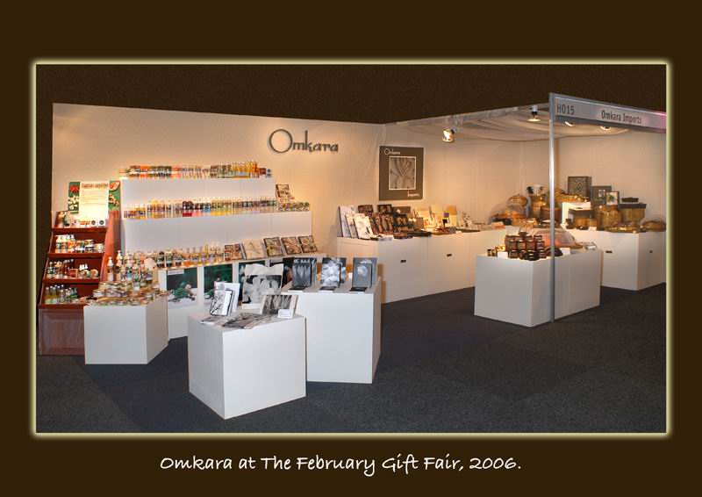
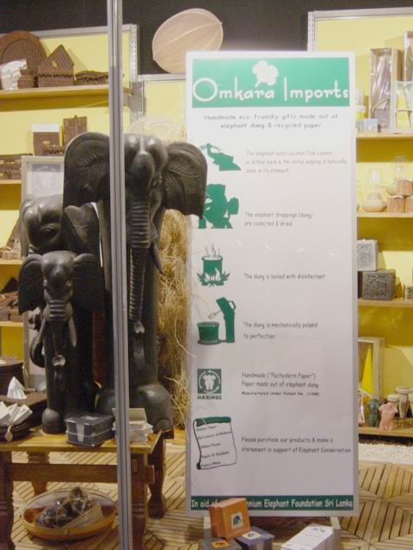
Australia Omkara Imports
“Conservation through Innovation”

Slide 17
Netherlands Wereld Winkel
“Conservation through Innovation”

Slide 18
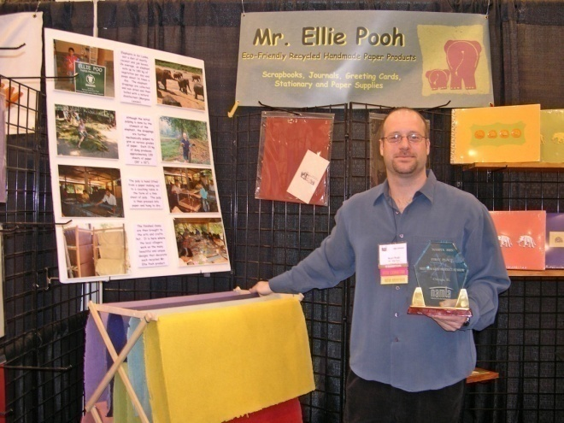
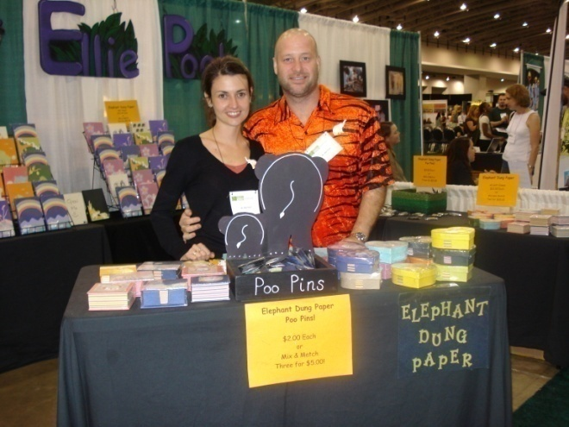
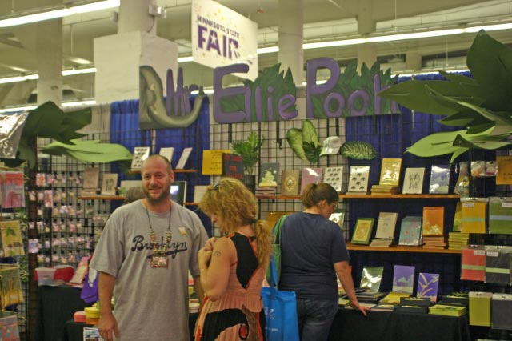
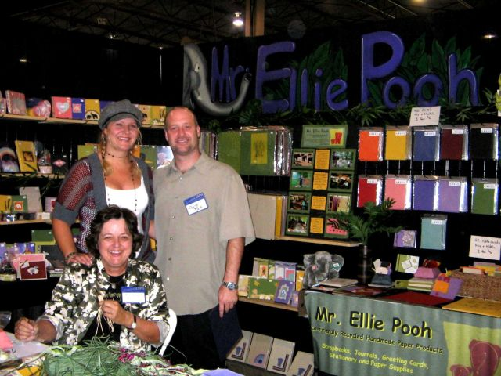
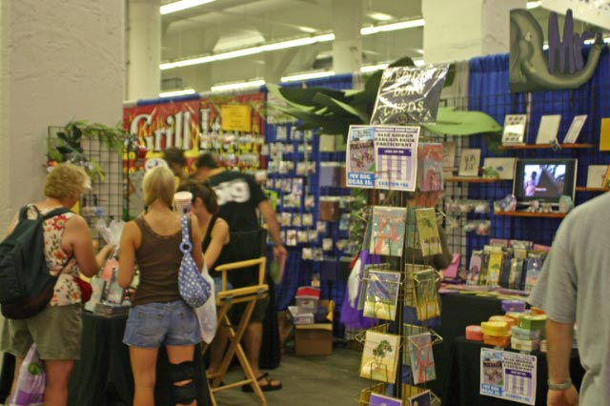
U.S.A Mr. Ellie Pooh
“Conservation through Innovation”

Slide 19
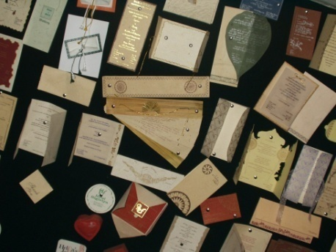
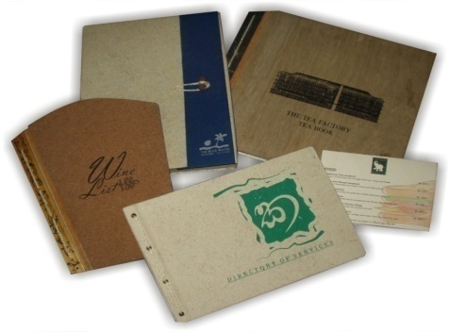
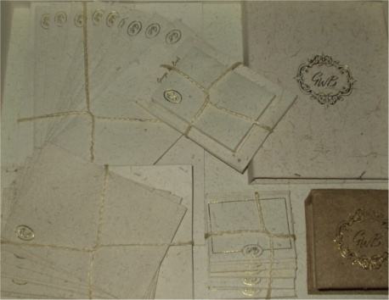
Evolution of Maximus!
Printers network
Custom solutions in dynamic printing industry
First Order – Wedding Card, Home Coming Card, Hymn Sheet, Cake Boxes for one customer
Other possibilities – Hotels, Corporate Gifts, Fancy Gift items
A special gift to president George Bush
“Conservation through Innovation”

Slide 20
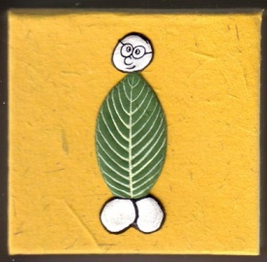
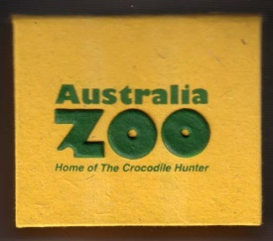
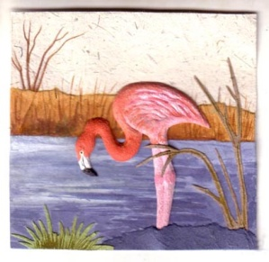
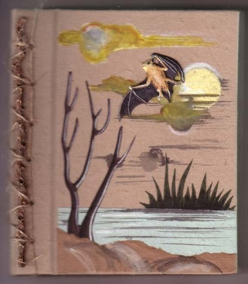
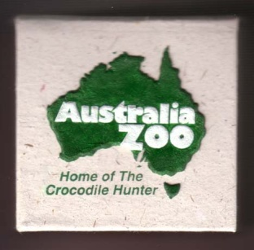
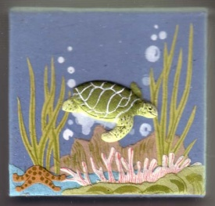
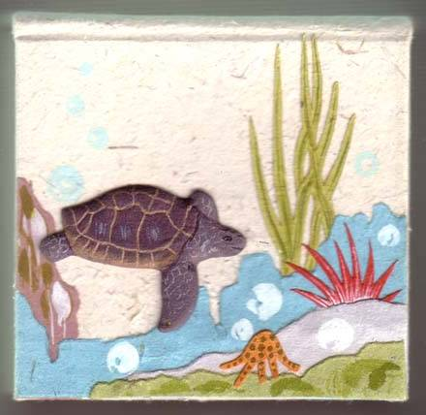
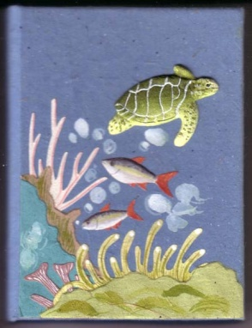
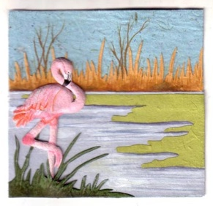
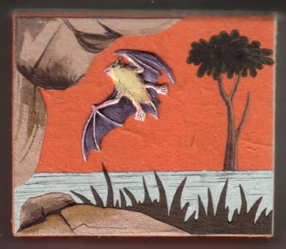
Innovative Customizing
Wedding Cards
Hotel
Gift Items
Zoos
Aquariums
“Conservation through Innovation”

Slide 21
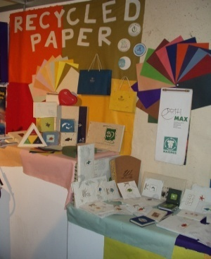
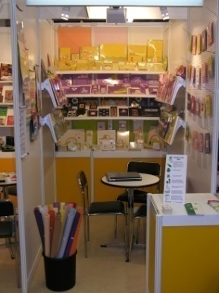
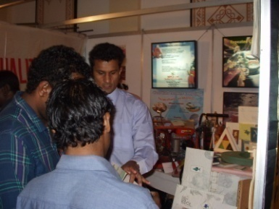
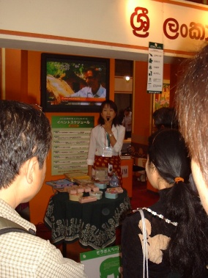
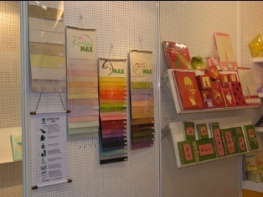
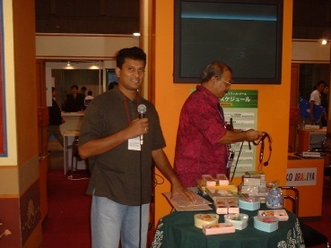
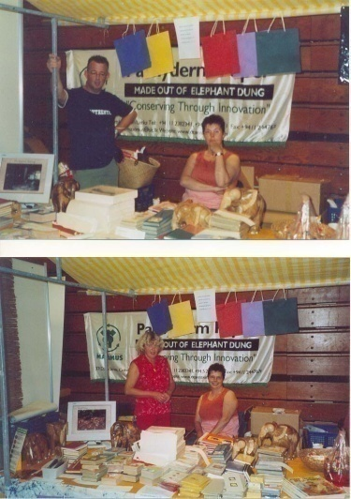
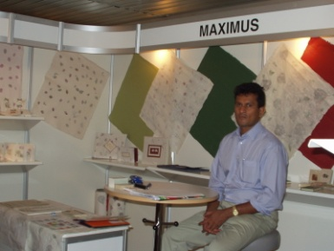
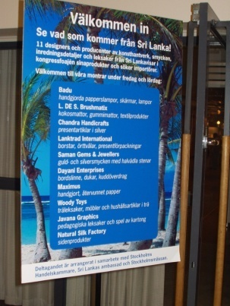
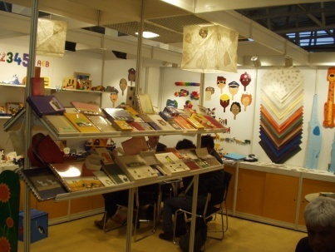
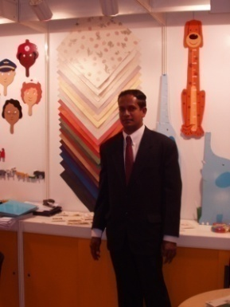
Exhibitions & Trade Fairs
MALDIVES - 2001
GERMANY - 2005
JAPAN - 1998
HOLLAND - 2004
SWEDEN - 2002
“Conservation through Innovation”
GERMANY - 2004

Slide 22
Facilitating an
Innovation driven Culture at Maximus
Develop a sense of history by regularly communicating landmark achievements of the company linking them to profitable conservation.
Create a sense of oneness by promoting from within to leadership roles whenever possible and communicating the norms and values of Maximus especially in relation to conservation.
Promote a sense of membership by production related incentive schemes and sending staff outside for training programs, annual recreation functions and opportunities to travel for trade exhibitions overseas.
Increase exchange among members by regular contact at core group meetings, participative decision making and use of day to day communication technology such as skype, emails etc.. locally as well as internationally
“Conservation through Innovation”

Slide 23
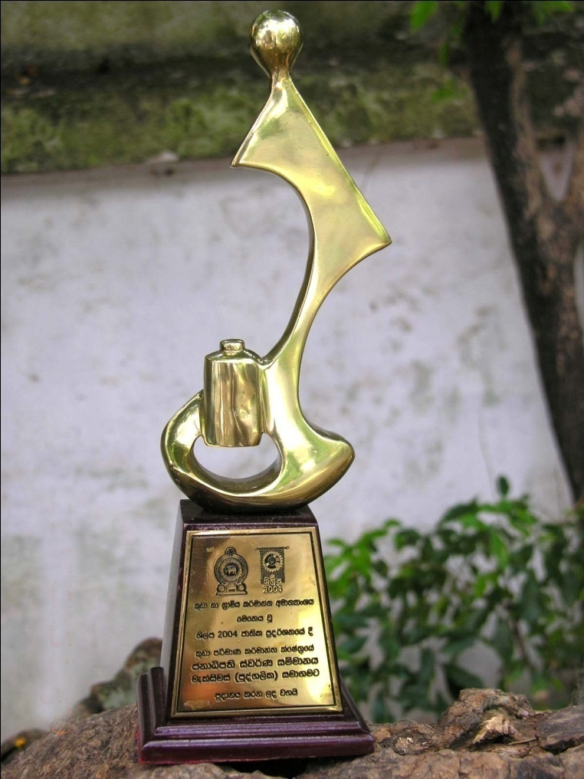
Presidential Gold Award for Entrepreneurship – Colombo Sri Lanka
Sri Lanka Presidential Gold Award for Entrepreneurship in the Small Industry Category (2004)
“Conservation through Innovation”

Slide 24
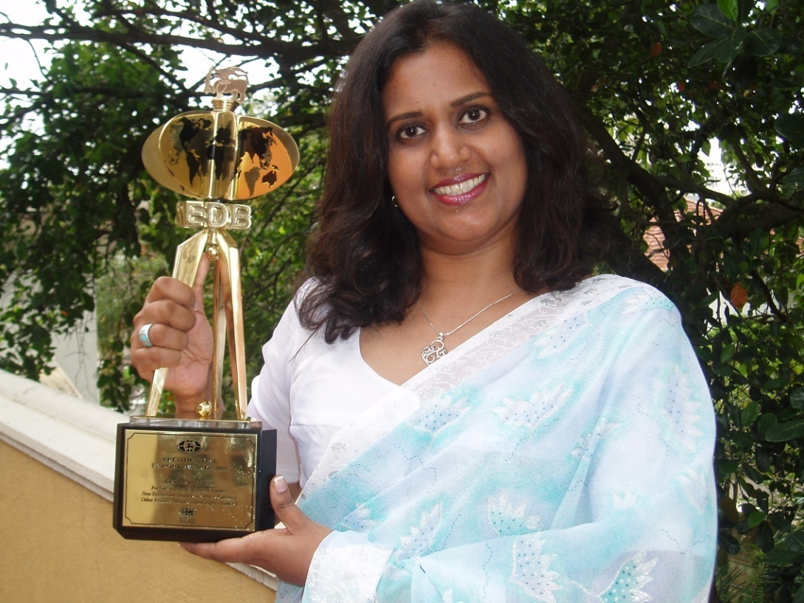
Presidential Export Award –
Colombo Sri Lanka
Presidential Export Award - Sri Lanka in the Other Category section awarded by the Export Development Board for the year 2006 awarded in September 2007.
“Conservation through Innovation”

Slide 25
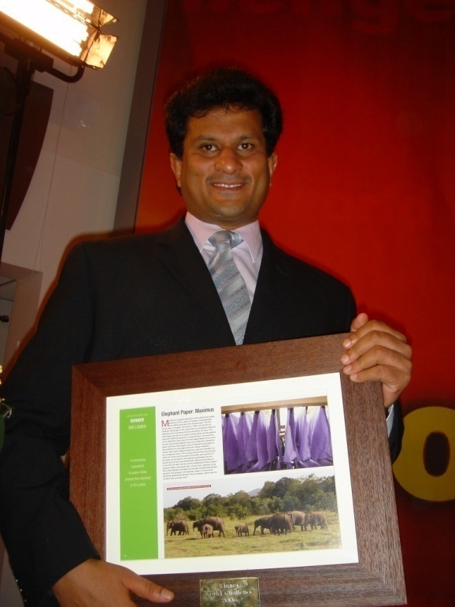
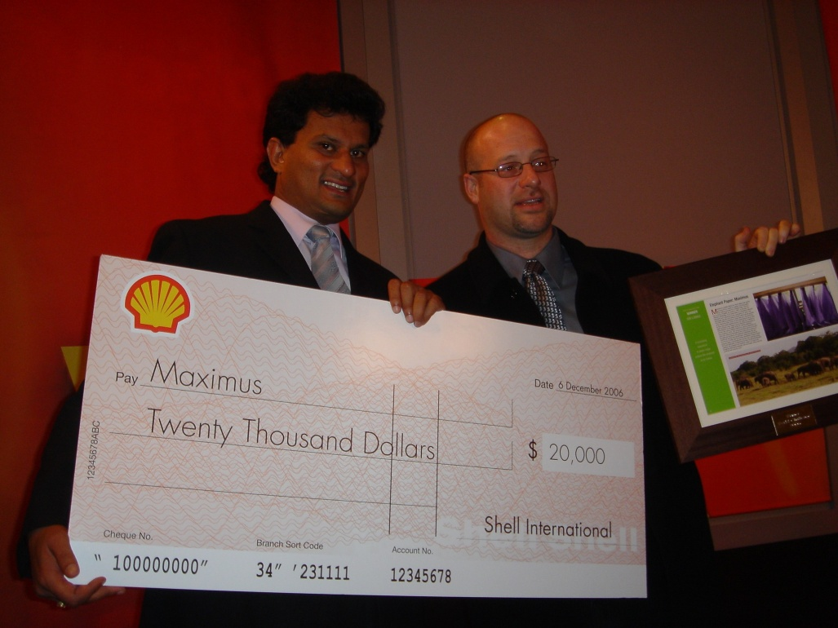
Winner of The World Challenge –
The Hague, Netherlands
Winner of The World Challenge for Entrepreneurship and contribution to sustainable development at the grass root level (2006) organized by the BBC, Newsweek Magazine and the Shell Company, The Hague, Netherlands.
“Conservation through Innovation”

Slide 26
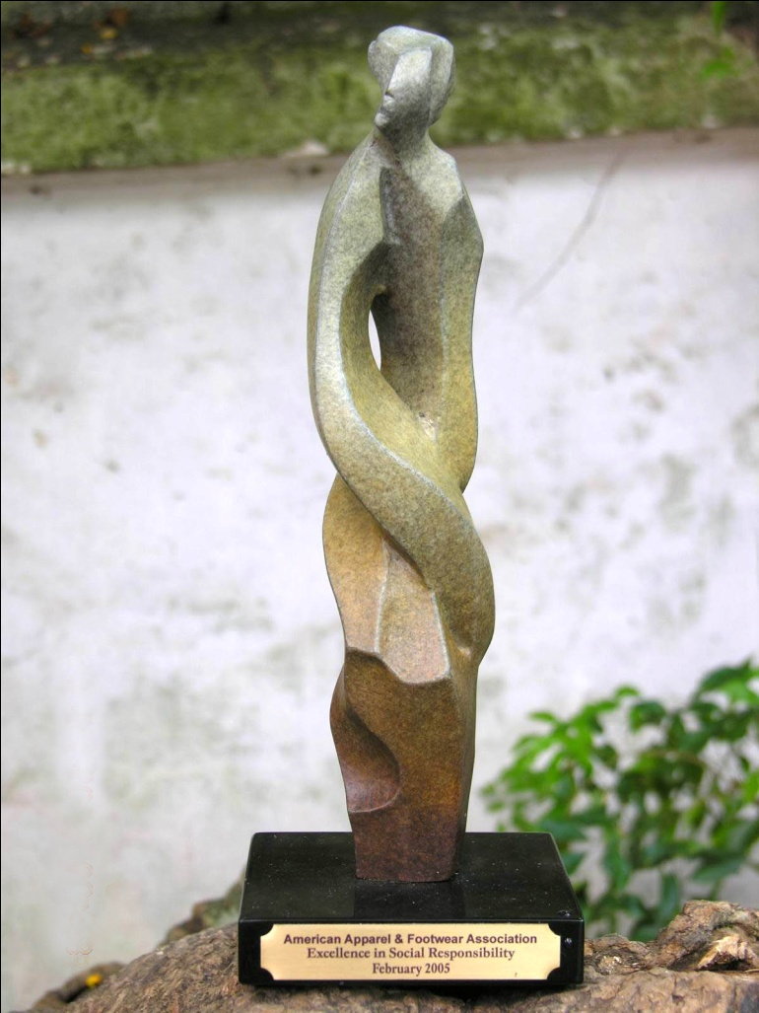
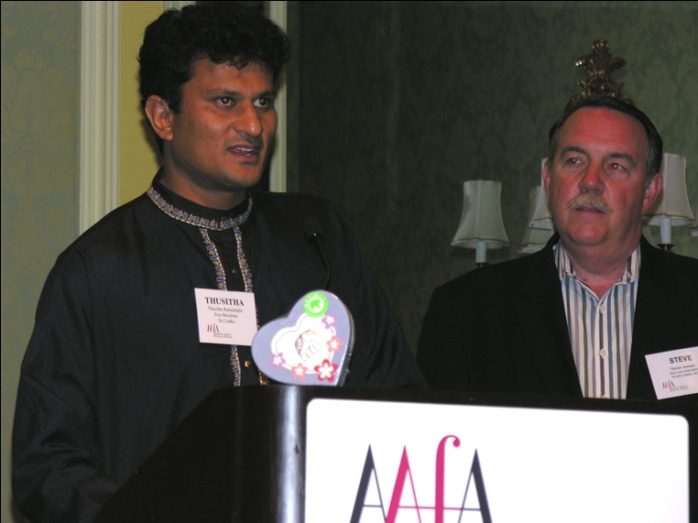
Excellence in Social Responsibility - Florida, U.S.A
Excellence in Social Responsibility (ESR) Award presented by the American Apparel and Footwear Association (AAFA), Florida, USA – February 2005
“Conservation through Innovation”

Slide 27
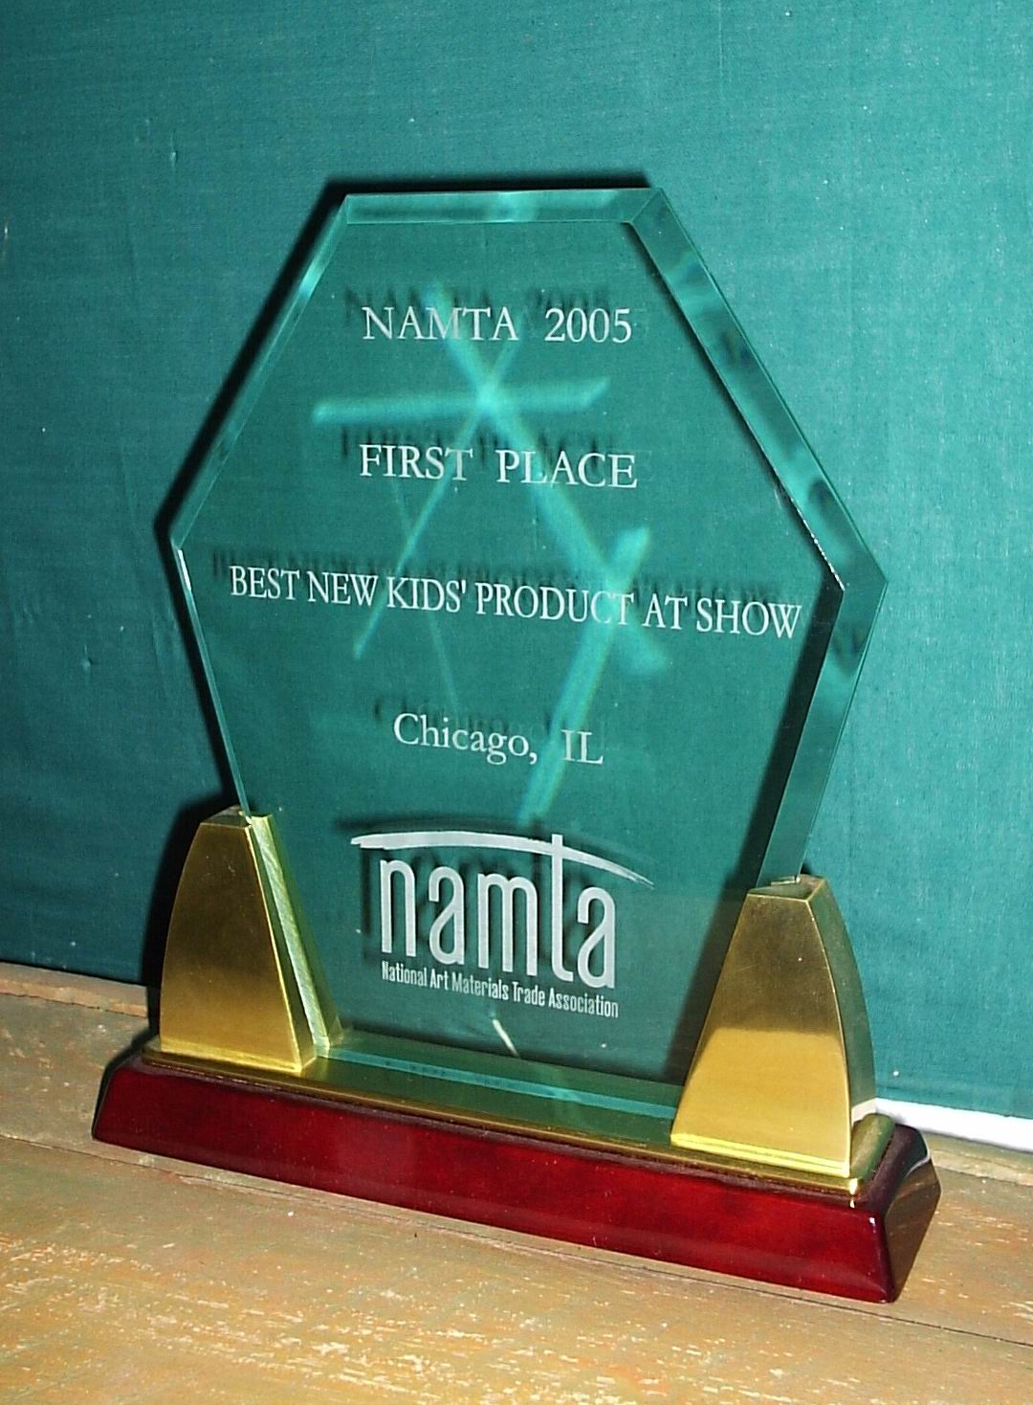
Best Kids Product – Chicago, U.S.A
First Place for Best New Kid's Product presented by the National Art Materials Trade Association (NAMTA),2007, Chicago, IL, USA
“Conservation through Innovation”

Slide 28
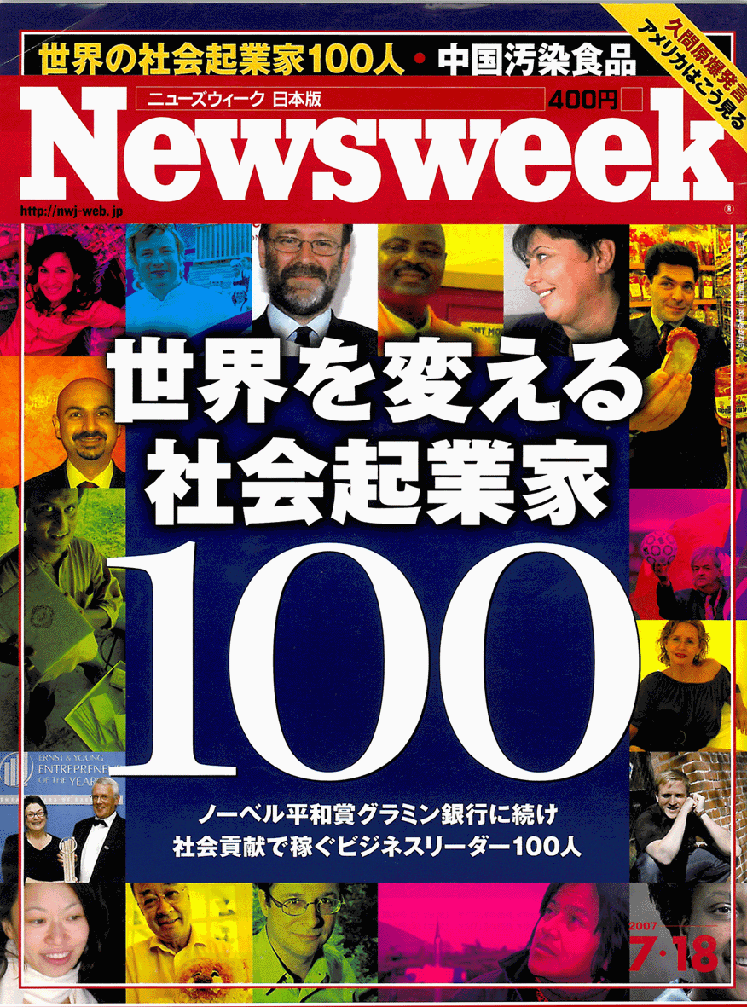
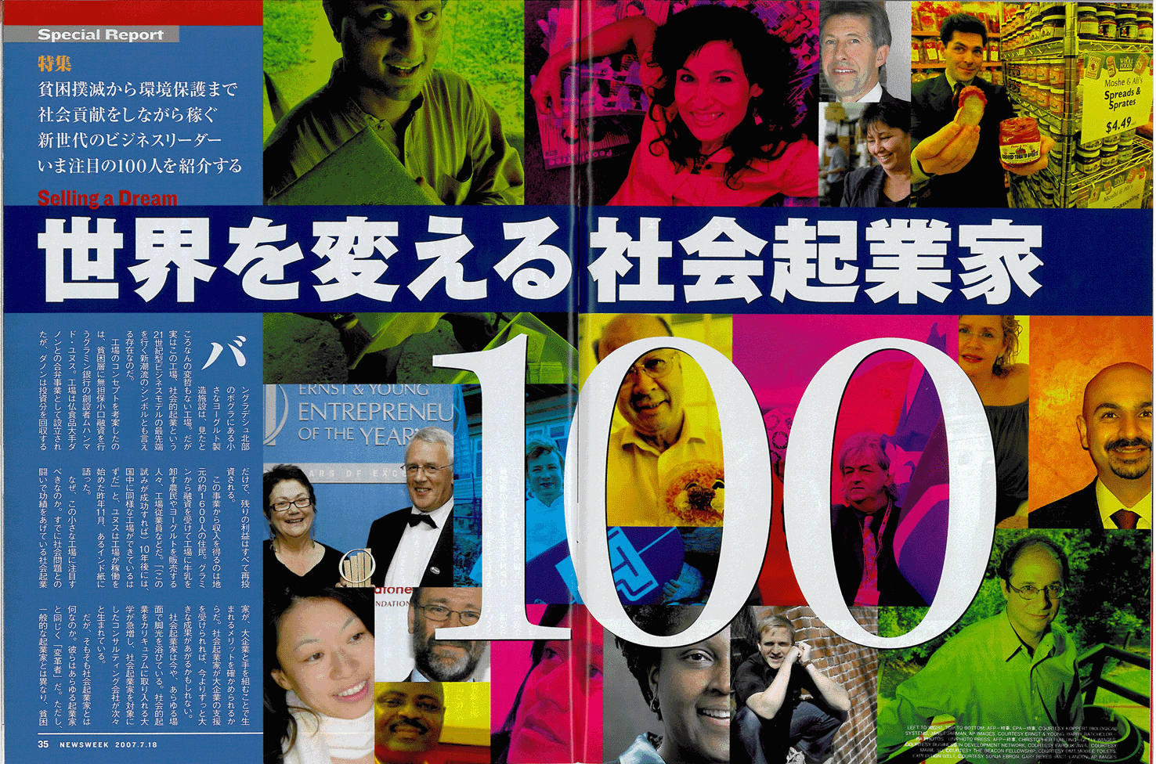
Newsweek cover page - Japan
Named by the Newsweek Magazine (Japanese Edition) as one of hundred Social Entrepreneurs affecting change in the world - June 2007.
“Conservation through Innovation”

Slide 29
Our Vision
“Conserving Nature by Recycling Waste - Profitably.”
“Conservation through Innovation”

Slide 30
The Human – Elephant Conflict in Sri Lanka
“Conservation through Innovation”

Slide 31
Maximus Sustainability
Available Land
Human Population
Conflict
Elephant Population
Government Policy
- Income Levels
- Income Method
- Job Opportunities
NGO / Government/
Private Support
- Food/Water
Availability
- Safety Requirements
- Migration Patterns
Solutions to Mitigate Conflict
Changing opportunities for
humans
- Changing perceptions of
humans
- Changing Government Policy
- Using Scientific Research on
elephants for their benefit
“Conservation through Innovation”

Slide 32
Maximus – Peace Paper
Address economic needs through rural empowerment
Add economic value to elephant in own habitat
Economic solutions make people receptive to conservation
People given economic reason to tolerate elephant in their neighborhood
Win Win situation for humans & elephants
Can we change the tide??
“Conservation through Innovation”

Slide 33
Maximus – Living Sustainability which is more than CSR

